Slide 1
Analysis report of SWAN Adaptor(24V/4A)
Conduction Test fail issue
2022. 09. 16
Notes:
1

Slide 2
1. Summary
1) Conduction Test status
1. Issue date : 22/05/24
2. Failure symptom & status : Some adaptor samples failed in conduction test at the factory(Foxconn)
3. Vendor EMI TEST status
1) 22/06/07 : Load (6Ω_with/without GND connection) condition in adaptor unit ( EMI TEST at the CTK Lab)
- Normal Adaptor : L1 (3.36 dB) / N (4.08dB)
- Failed Adaptor : L1 (6.21 dB) / N (4.43dB)
2) 22/06/23 : STB streaming with adaptor ( EMI TEST at the EMTI Lab)
> Test Result: FAIL
> Test passed when transformer and line filter changed
- Failed Adaptor : L1 / N (-3.82 dB)
- After changing transformer ad line filter : L1 / N (5.9 dB)
3) Additional EMI TEST result
1) 22/07/11: Changed LINE FILTER’s wire turn(Ts 63 ~ 69): Fail
2) 22/07/15: LINE FILTER’s wire turns(Ts 60) & wire turn alignment(appearance): PASS
3) 22/07/28: LINE FILTER’s wire turns(Ts 60) & wire turn alignment(appearance) by factory machine: PASS
4) 22/09/15: Sample production by production :Pass

Slide 3
1. Summary
4) Efficacy evaluation EMI TEST result (22/10/27 update)
: LINE FILTER’s wire turns(Ts 60) & wire turn alignment(appearance) by factory machine of efficacy check
a) OK LINE FILTER 10EA EMI Test results
-> All 10ea result to 3dB or more margin : Pass
b) Limit approval LINE FILTER’s 20EA EMI Test results
-> All 20ea result to 3dB or more margin : Pass
c) NG LINE FILTER’s 20EA EMI Test result
-> Test results less than 3dB or over : Fail

Slide 4
2. Vendor conduction Testing status
1) 22/06/07 : Test only Adaptor Unit
Load Condition: 6Ω_with & without GND connection
  Testing Lab: CTK Lab
  Result: Pass
- Normal Adaptor sample: L1 (3.36 dB) / N (4.08dB)
- Failed Adaptor sample : L1 (6.21 dB) / N (4.43dB)

Slide 5
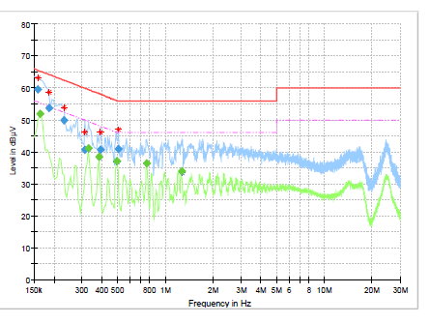
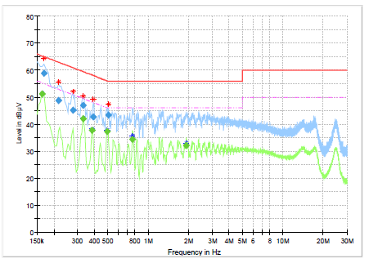
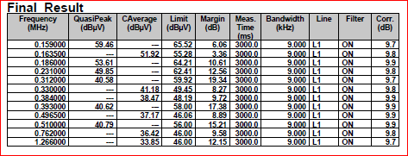
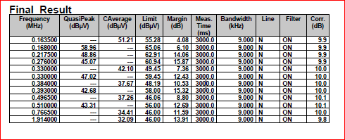
2. Vendor conduction Testing status(22/06/07): Normal Adaptor sample
MODEL : LA-B271KL-DA
Test Condition : 220V/60Hz
Test AMBIENT : 25℃
4. Test place : CTK
5. Load Condition : 6ohm Load
6. date : 6/7,
#1 Input : 220V/60Hz / L1 | #1 Input : 220V/60Hz / N
MIN 3.36dB (163KHz) | MIN 4.08dB (163KHz)

Slide 6
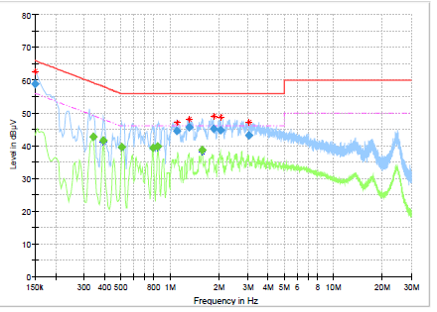
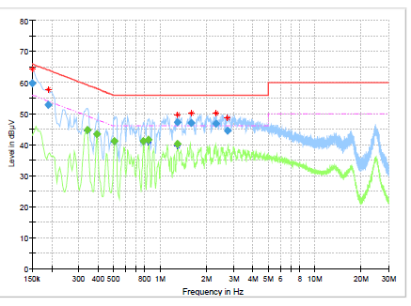
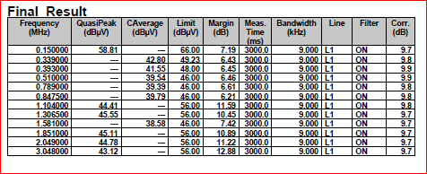
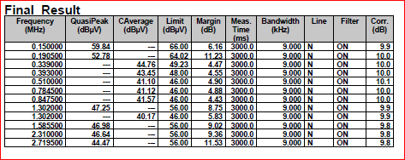
2. Vendor conduction Testing status(22/06/07): Failed Adaptor sample
MODEL : LA-B271KL-DA
Test Condition : 220V/60Hz
Test AMBIENT : 25℃
4. Test place : CTK
5. Load Condition : 6ohm Load
6. date : 6/7,
#2 Input : 220V/60Hz / L1 | #2 Input : 220V/60Hz / N
MIN 3.36dB (163KHz) | MIN 4.08dB (163KHz)
Test result : Pass

Slide 7
2. Vendor conduction Testing status
2) 22/06/23 : DUT with SWAN STB
Load Condition: STB live streaming
  Test Lab: EMTI(Korea Electromagnetic wave Technology Institute) Lab
  Result: Fail(Test passed when transformer and line filter changed)
- NG Adaptor : L1 / N (-3.82 dB)
- After change transformer and line filter : L1 / N (5.9 dB)

Slide 8
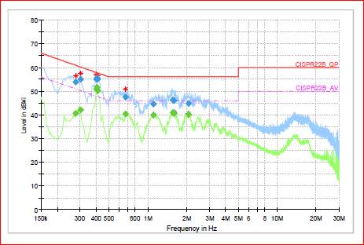
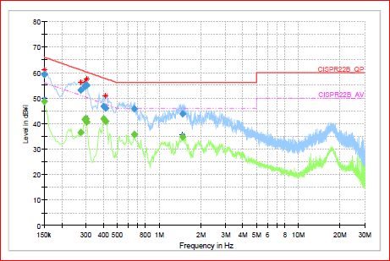
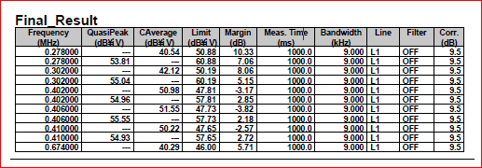
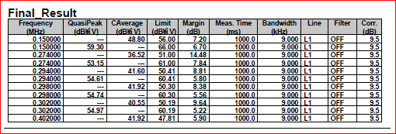
2. Vendor conduction Testing status(22/06/23): Failed Adaptor sample
MODEL : LA-B271KL-DA
Test Condition : 220V/60Hz
Test AMBIENT : 25℃
4. Test place :EMTI
5. Load Condition : STB live streaming
6. data : 6/23
#2 Input : 220V/60Hz / L1 | #2 Input : 220V/60Hz / N
MIN -3.82dB (406KHz) → FAIL | MIN 5.9dB (402KHz) → PASS
시험 결과 : ALT SET LOAD 측정 시 FAIL → TRASN, LINE FILTER 1:1 교체 후 TEST 시 PASS (CISPR22B AV 기준 3dB↑)

Slide 9
3. Additional Conduction Test
1) 22/07/11: Changed LINE FILTER’s wire turn(Ts 63 ~ 69)
22/07/11: Changed LINE FILTER’s wire turn(Ts 63 ~ 69)
  Test result: FAIL
No | Sort | Spec. | Unit#1 | Unit#2 | Unit#3 | Unit#4 | Unit#5 | Unit#6
1 | Ts | 66+/-3 | 62 | 63 | 64 | 65 | 66 | 67
2 | Inductance | 28uH+50%, -30% | 25.7uH | 26.9uH | 28.6uH | 29.6uH | 30.3uH | 30.8uH
3 | DCR | 200m ohm(max) | 177m ohm | 180m ohm | 184m ohm | 187m ohm | 190m ohm | 196m ohm
4 | EMI | Over 3dB | 793KHz | 847KHz | - | 793KHz | 798KHz | -
 |  |  | -2.33dB | -2.32dB | - | -1.75dB | -0.21dB | -
 | Result |  | Fail | Fail | Fail | Fail | Fail | Fail

Slide 10
3. Additional Conduction Test
2) 22/07/15: LINE FILTER’s wire turns(Ts 60) & wire turn alignment(appearance)
22/07/15: LINE FILTER’s wire turns(Ts 60) & wire turn alignment(appearance)
  Test result : PASS

Slide 11
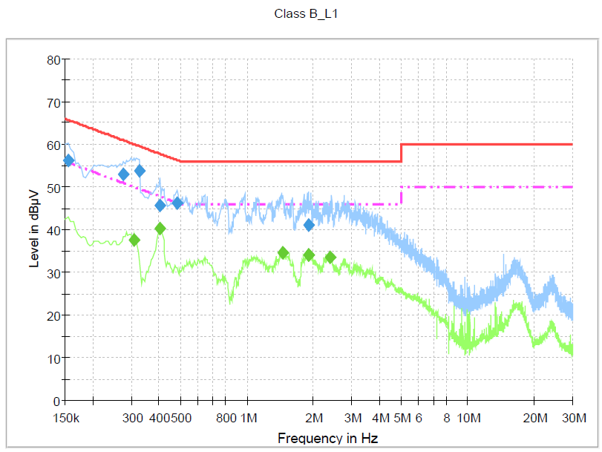
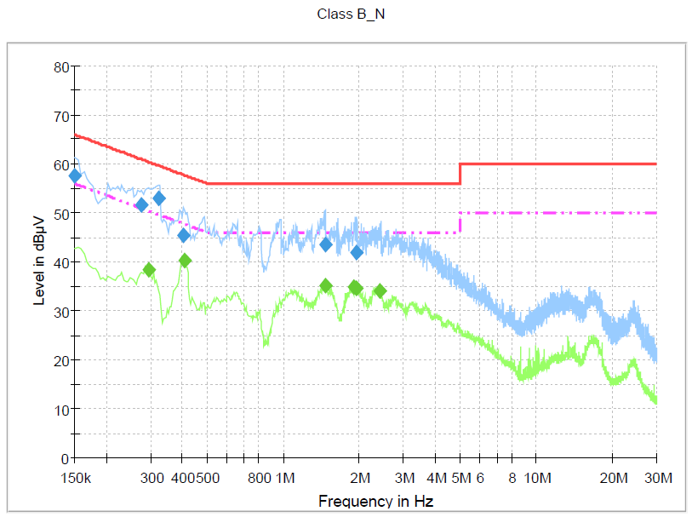
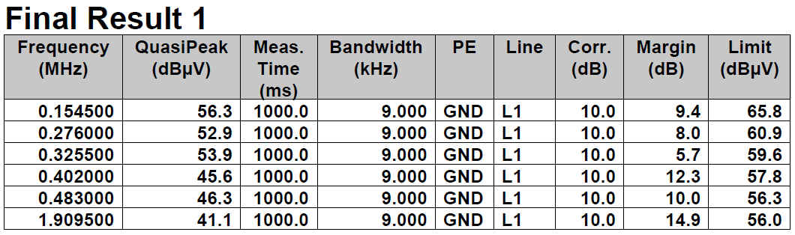
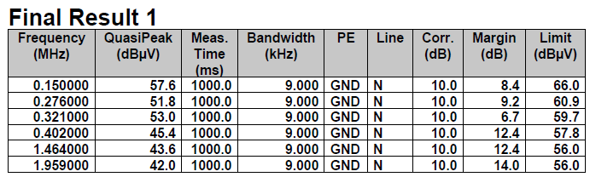
3. Additional Conduction Test(Ts 60 & wire turn alignment(appearance))
: Normal Adaptor
MODEL : LA-B271KL-DA
Test Condition : 220V/60Hz
Test AMBIENT : 25℃
4. Test place :EMTI
5. Load Condition : STB live streaming
6. Data : 7/15
#1 Input : 220V/60Hz / L1 | #1 Input : 220V/60Hz / N
MIN 5.7dB (276KHz) → PASS | MIN 6.7dB (321KHz) → PASS

Slide 12
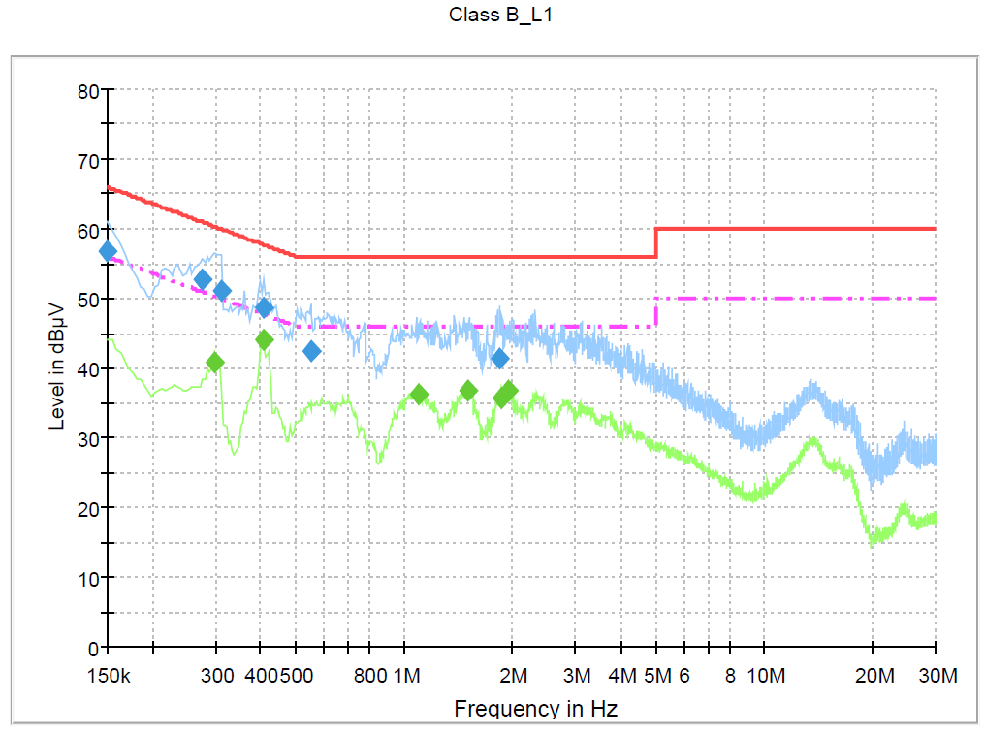

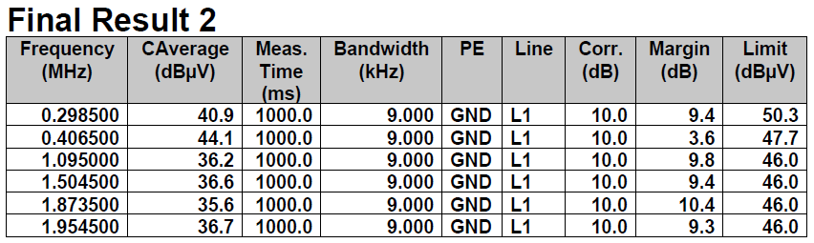
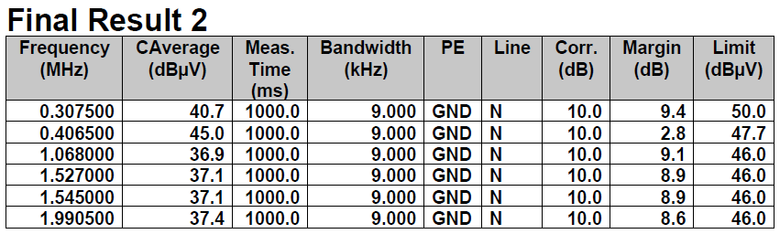
3. Additional Conduction Test(Ts 60 & wire turn alignment(appearance))
: Failed Adaptor
MODEL : LA-B271KL-DA
Test Condition : 220V/60Hz
Test AMBIENT : 25℃
4. Test place :EMTI
5. Load Condition : STB live streaming
6. Data : 7/15
#2 Input : 220V/60Hz / L1 | #2 Input : 220V/60Hz / N
MIN 3.6dB (406KHz) → PASS | MIN 2.8dB (402KHz) → PASS

Slide 13
3. Additional Conduction Test
3) 22/07/28: LINE FILTER’s wire turns(Ts 60) & wire turn alignment(appearance) by factory machine
22/07/28: LINE FILTER’s wire turns(Ts 60) & wire turn alignment(appearance) by factory machine
> Test result : PASS

Slide 14
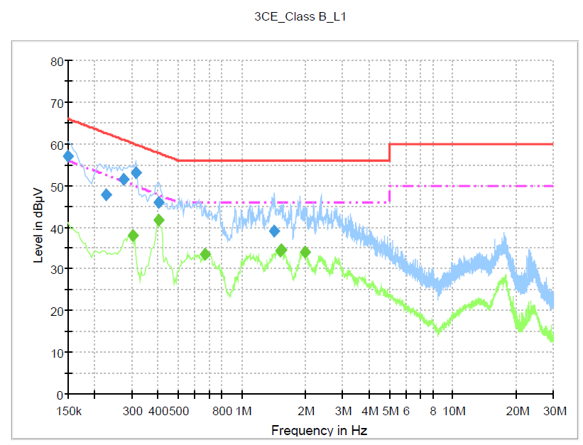
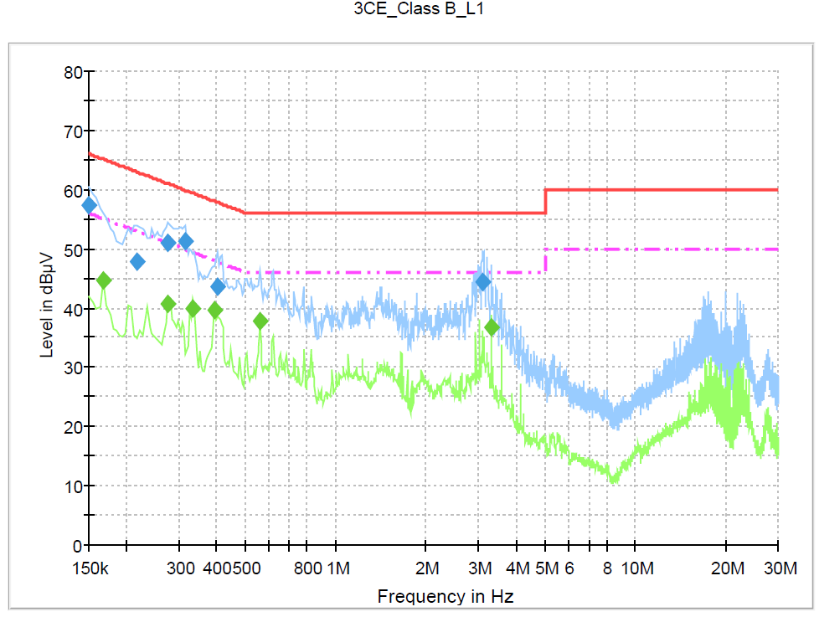
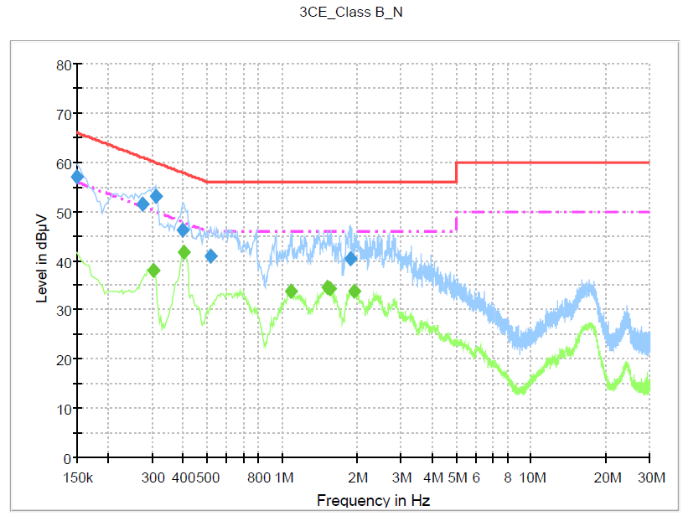
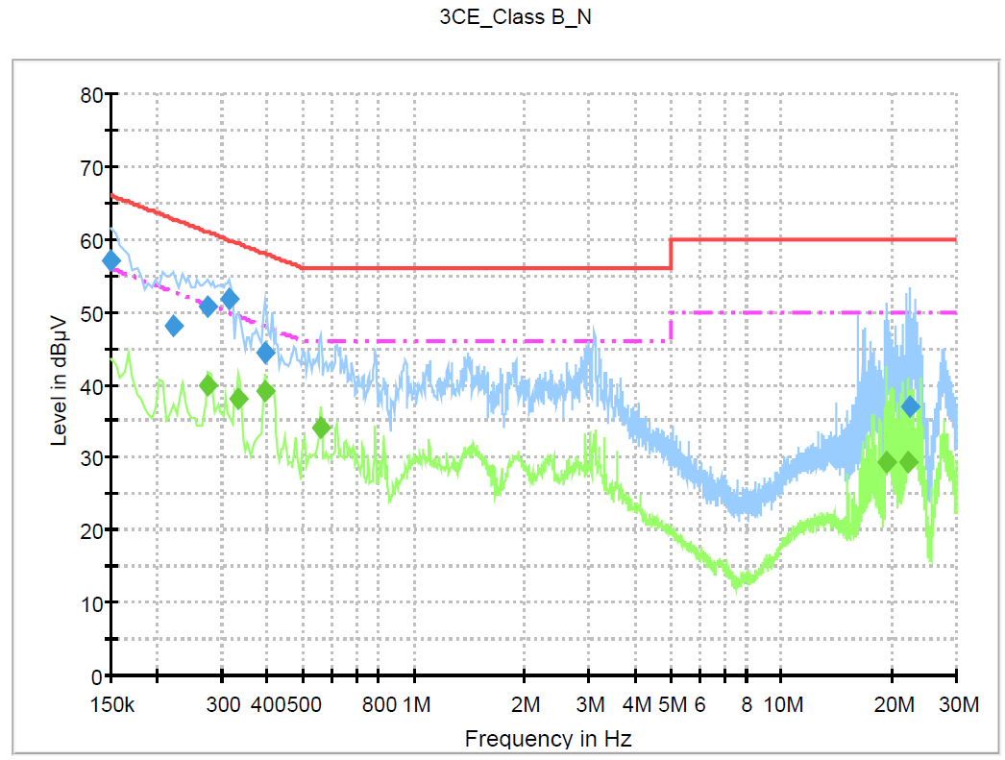
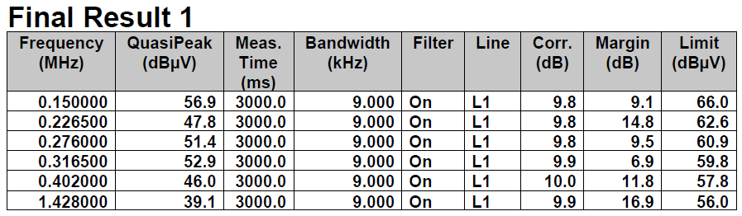
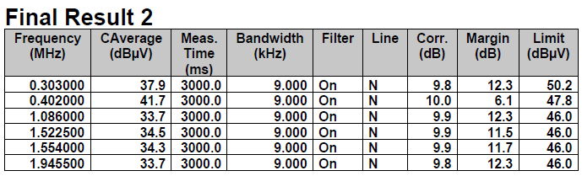
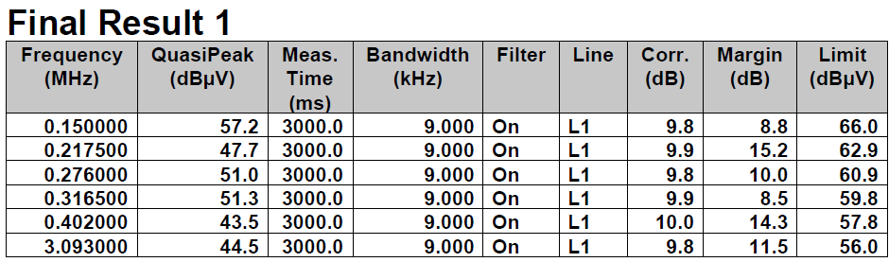
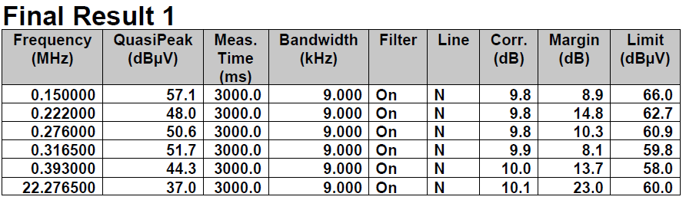
3. Additional Conduction Test(Ts 60 & 66) & wire turn alignment(appearance) by factory machine
MODEL : LA-B271KL-DA
Test Condition : 220V/60Hz
Test AMBIENT : 25℃
4. Test place :CTK
5. Load Condition : STB live streaming
6. Date : 7/28
구분 | #1 Input : 220V/60Hz / L1 |  | #1 Input : 220V/60Hz / N
Ts | Ts 66 | Ts 60 | Ts 66 | Ts 60
Ts 66
Ts 60
Result | Ts 66 : MIN 6.9dB (316KHz) → PASS Ts 60 : MIN 8.5dB (316KHz) → PASS |  | Ts 66 : MIN 6.1dB (402KHz) → PASS Ts 60 : MIN 8.1dB (316KHz) → PASS

Slide 15
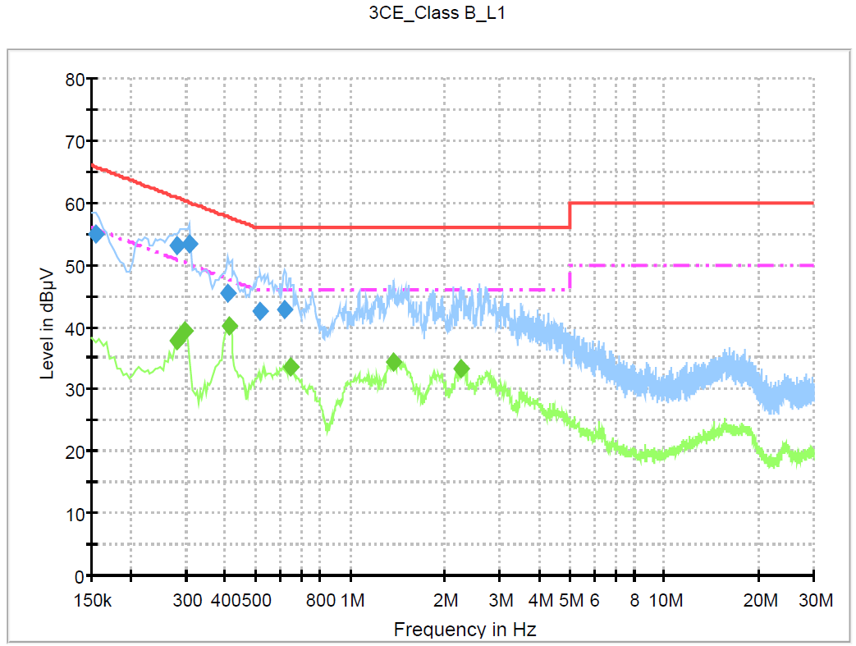
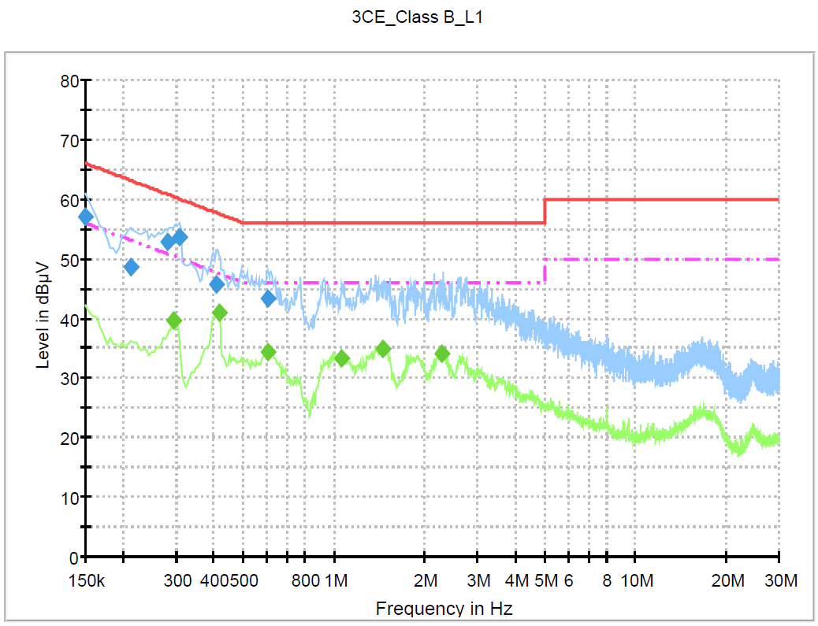
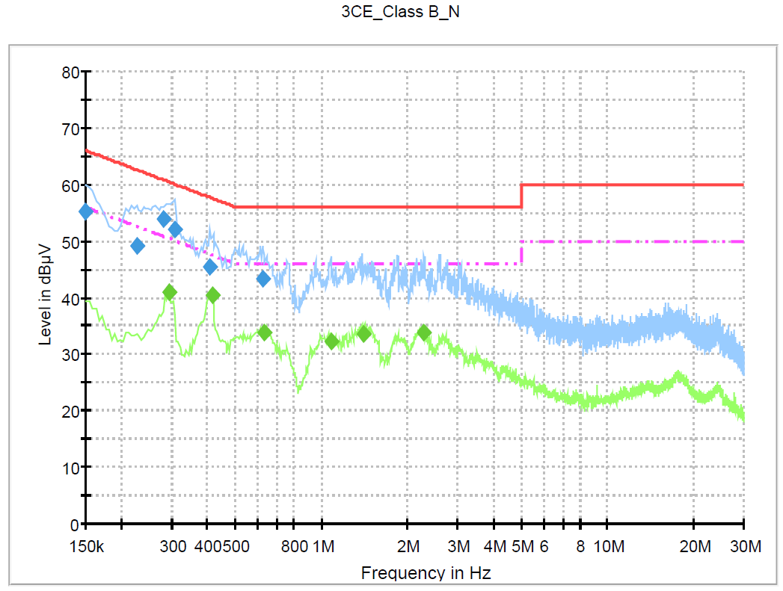
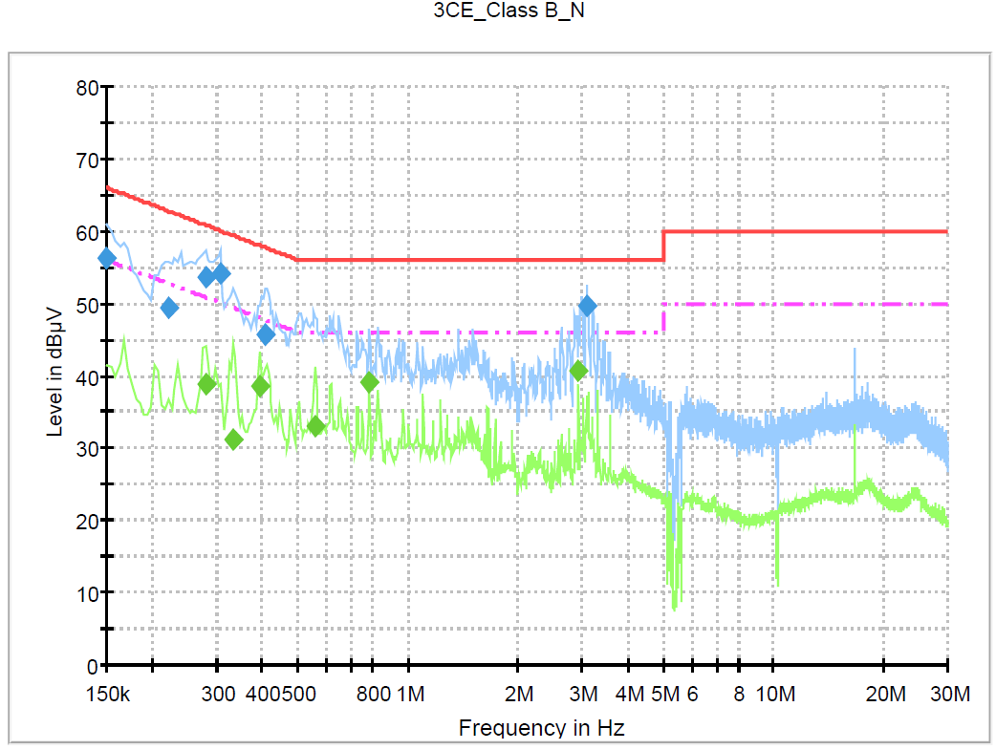
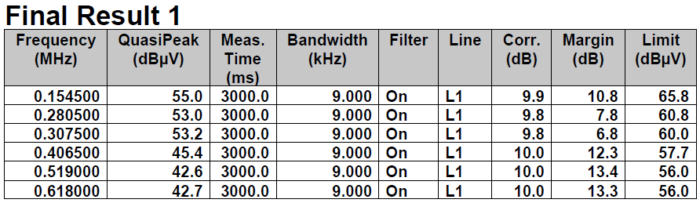
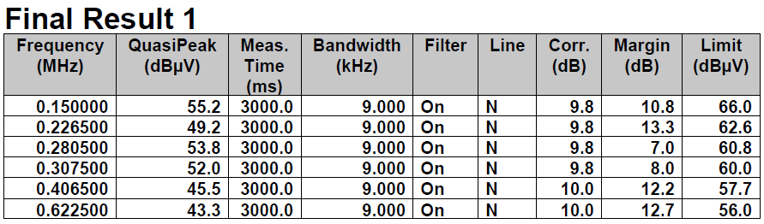
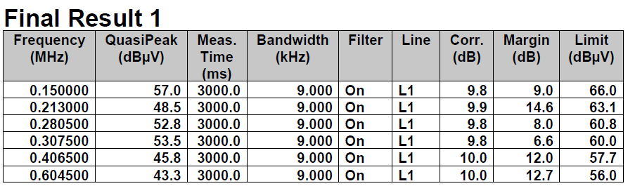
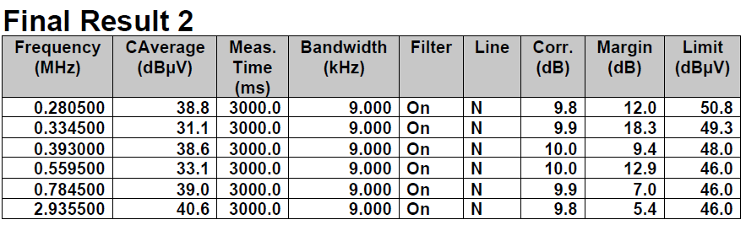
3. Additional Conduction Test(Ts 60 & 66) & wire turn alignment(appearance) by factory machine
MODEL : LA-B271KL-DA
Test Condition : 220V/60Hz
Test AMBIENT : 25℃
4. Test place :CTK
5. Load Condition : STB live streaming
6. date : 7/28
구분 | #2 Input : 220V/60Hz / L1 |  | #2 Input : 220V/60Hz / N
Ts | Ts 66 | Ts 60 | Ts 66 | Ts 60
Ts 66
Ts 60
Result | Ts 66 : MIN 6.8dB (307KHz) → PASS Ts 60 : MIN 6.6dB (307KHz) → PASS |  | Ts 66 : MIN 7.0dB (280KHz) → PASS Ts 60 : MIN 5.4dB (2935KHz) → PASS

Slide 16
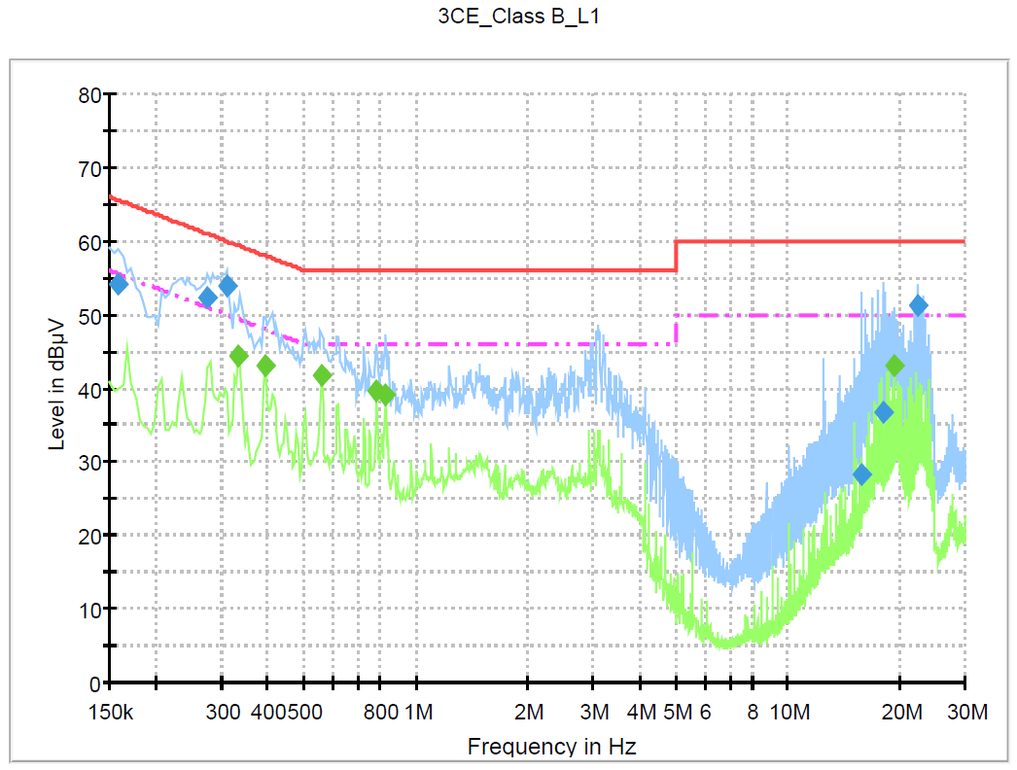
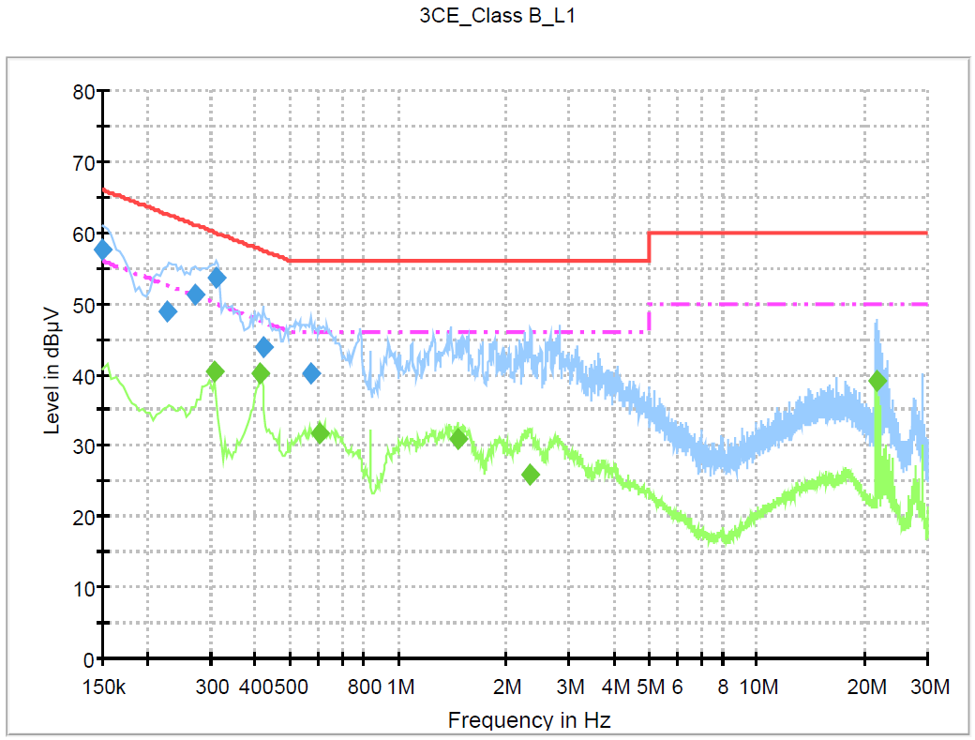
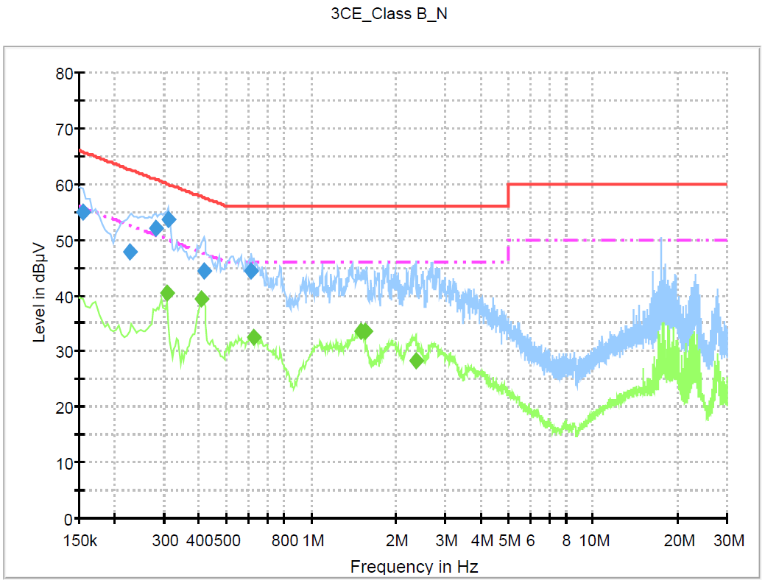
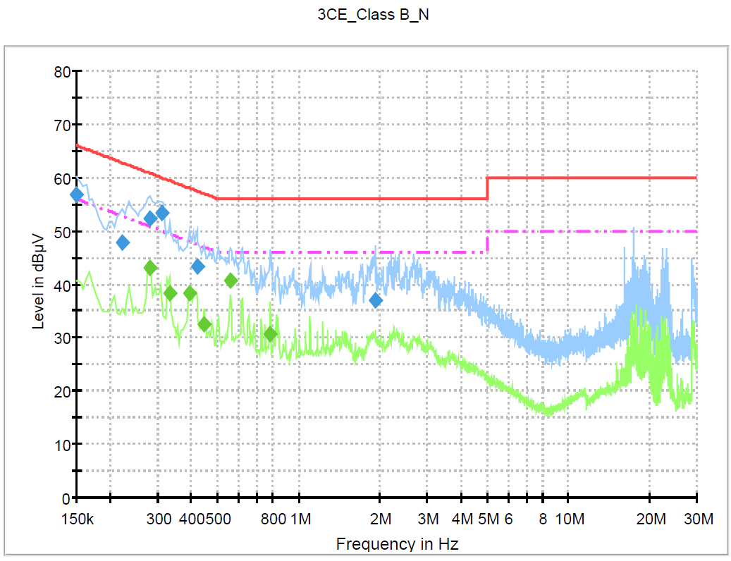
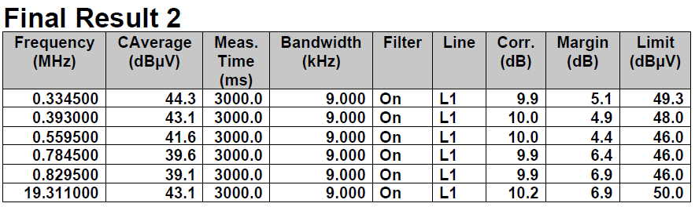
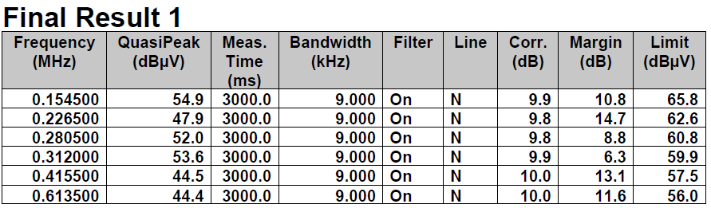
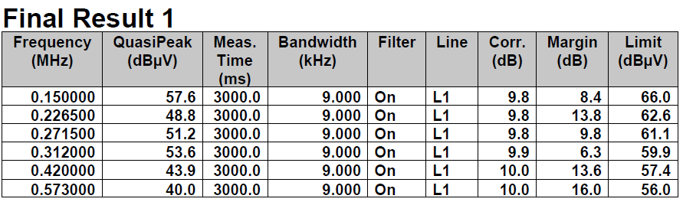
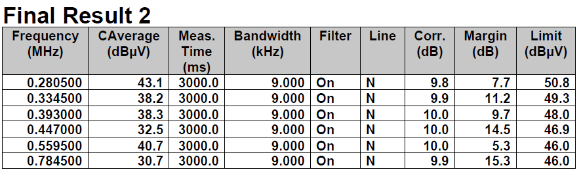
3. Additional Conduction Test(Ts 60 & 66) & wire turn alignment(appearance) by factory machine
MODEL : LA-B271KL-DA
Test Condition : 220V/60Hz
Test AMBIENT : 25℃
4. Test place :CTK
5. Load Condition : STB live streaming
6. date : 7/28
구분 | #3 Input : 220V/60Hz / L1 |  | #3 Input : 220V/60Hz / N
Ts | Ts 66 | Ts 60 | Ts 66 | Ts 60
Ts 66
Ts 60
Result | Ts 66 : MIN 4.4dB (559KHz) → PASS Ts 60 : MIN 6.3dB (312KHz) → PASS |  | Ts 66 : MIN 6.3dB (312KHz) → PASS Ts 60 : MIN 5.3dB (559KHz) → PASS

Slide 17
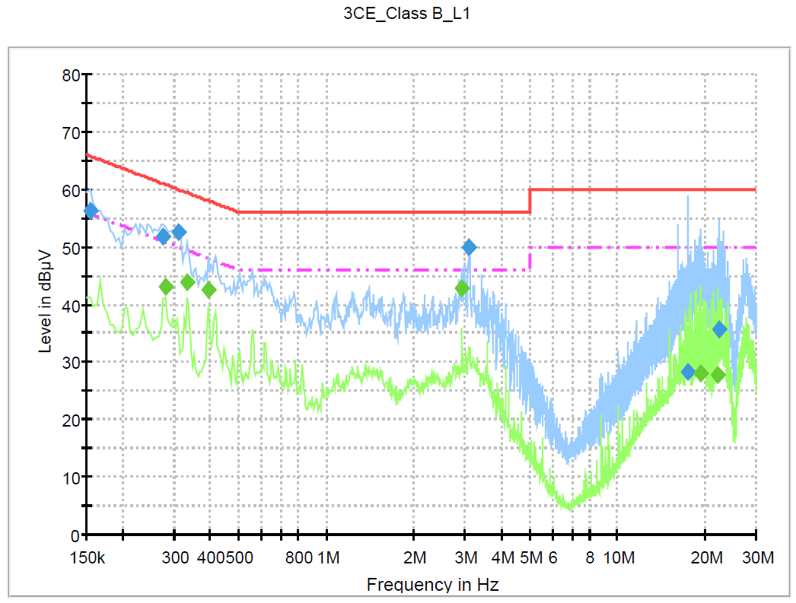
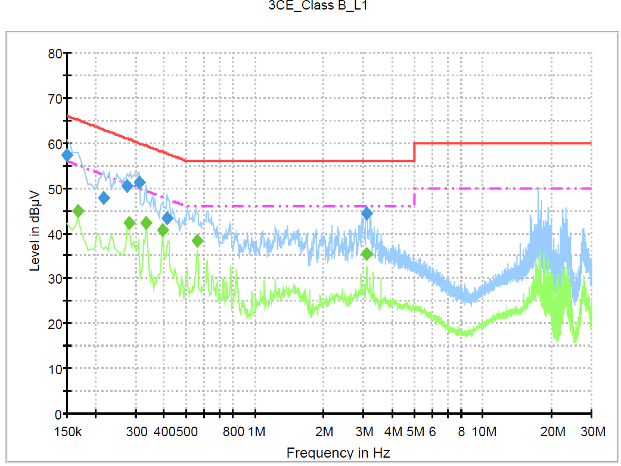
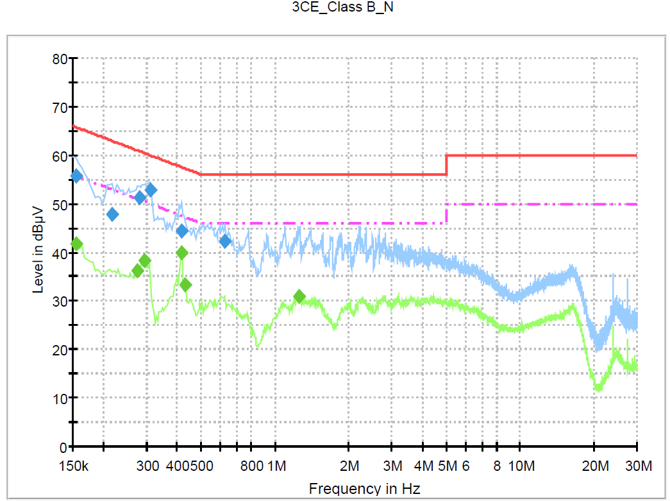
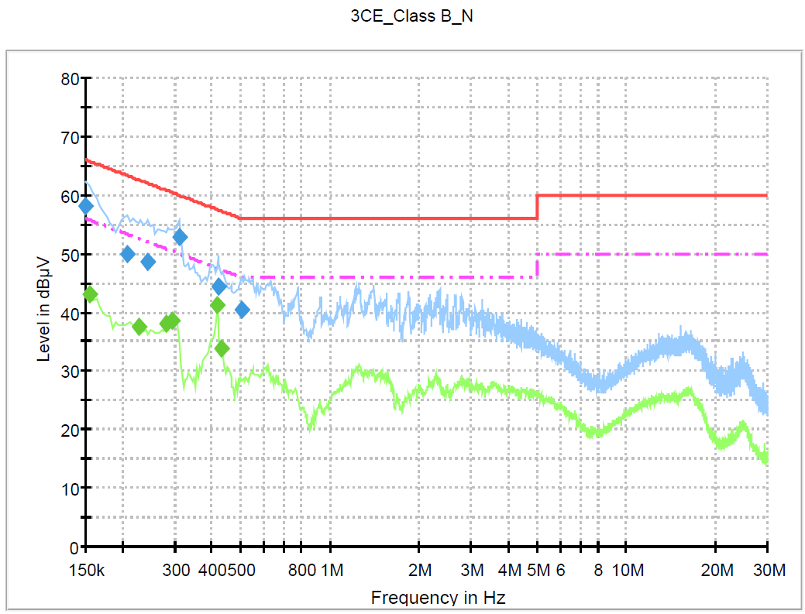
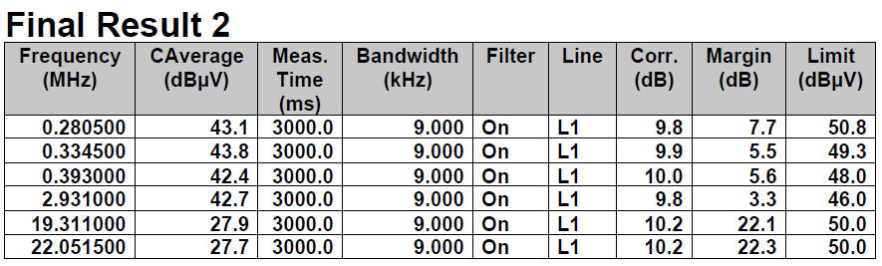

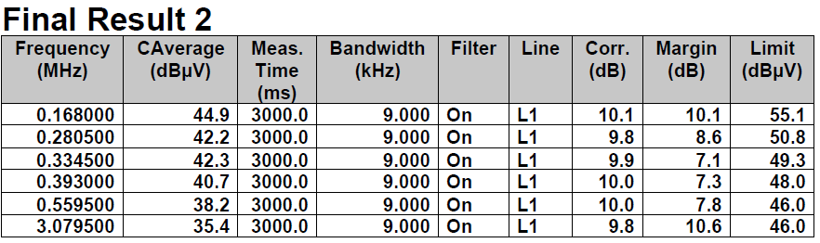
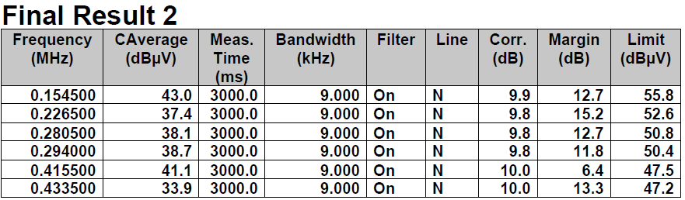
3. Additional Conduction Test(Ts 60 & 66) & wire turn alignment(appearance) by factory machine
MODEL : LA-B271KL-DA
Test Condition : 220V/60Hz
Test AMBIENT : 25℃
4. Test place :CTK
5. Load Condition : STB live streaming
6. date : 7/28
구분 | #4 Input : 220V/60Hz / L1 |  | #4 Input : 220V/60Hz / N
Ts | Ts 66 | Ts 60 | Ts 66 | Ts 60
Ts 66
Ts 60
Result | Ts 66 : MIN 3.3dB (2931KHz) → PASS Ts 60 : MIN 7.3dB (393KHz) → PASS |  | Ts 66 : MIN 6.1dB (402KHz) → PASS Ts 60 : MIN 8.1dB (316KHz) → PASS

Slide 18



2. Failure symptom & CONTAINMENT PLAN
Failure symptom & Cause analysis (Line filter vendor) | CONTAINMENT PLAN
 | 4. CONTAINMENT PLAN 1)Sample samples 10EA out of 30EA Sample production by production plant, scheduled to be tested on August 22nd 2) Reinforcement of LINE FILTER Visual inspection Standards Attached reference 3) Future Plan Efficacy evaluation(TBD)

Slide 19


4. Cpk Analysis (Ts 66 / Ts 60, Wire alignment Test)
Ts 66
Ts 60

Slide 20

5. Additional Conduction sample production by production
MODEL : LA-B271KL-DA
Test Condition : 220V/60Hz
Test AMBIENT : 25℃
4. Test place :CTK
5. Load Condition : STB live streaming
6. date : 9/15

Slide 21

6. Efficacy evaluation EMI TEST result
MODEL : LA-B271KL-DA
Test Condition : 220V/60Hz
Less than 3dB margin: Fail
3.Line Filters :OK /Limit approval/ NG
4. Load Condition : STB live streaming
5. EMI DATA of attached
OK | 1 | 2 | 3 | 4 | 5 | 6 | 7 | 8 | 9 | 10
Result | PASS | PASS | PASS | PASS | PASS | PASS | PASS | PASS | PASS | PASS
Limit | 1 | 2 | 3 | 4 | 5 | 6 | 7 | 8 | 9 | 10
Result | PASS | PASS | PASS | PASS | PASS | PASS | PASS | PASS | PASS | PASS
Limit | 11 | 12 | 13 | 14 | 15 | 16 | 17 | 18 | 19 | 20
Result | PASS | PASS | PASS | PASS | PASS | PASS | PASS | PASS | PASS | PASS
NG | 1 | 2 | 3 | 4 | 5 | 6 | 7 | 8 | 9 | 10
Result | -0.26dB | 0.43dB | 0.13dB | 0.04dB | 0.07dB | 0.69dB | 0.69dB | 0.72dB | 1.47dB | -0.32dB
NG | 11 | 12 | 13 | 14 | 15 | 16 | 17 | 18 | 19 | 20
Result | 0.76dB | 1.32dB | 1.88dB | -0.08dB | -1.06dB | 0.44dB | 0.92dB | 0.41dB | 0.77dB | 1.65dB

Slide 22
7. Conclusion
Conduction issue caused by line filter part
-> Use only the OK and Limit approval Line Filter for the following supply adaptors.
(We supply only products that pass the LINE FILTER visual inspection standard)

